Slide 1
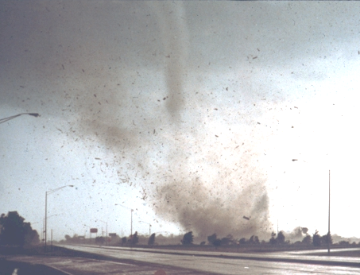
Tornado Drill !!!
Follow an usher NOW as they lead you to a designated shelter location.
Photo: 1982 Marion, IL Tornado Courtesy Don Fisher

